Slide 1
Operating Systems
IPC: Inter-processes Communication
Vassilis Markos,
Mediterranean College
Week 10

Slide 2
Concurrency

Slide 3
IPC So Far
So far we have explored the following IPC mechanisms:
Pipes
Shared Memory
Message Queues
Signals
With all this machinery we have managed to solve a simple scenario of IPC between a parent and a forked child process.
How do all these manners compare?

Slide 4
What Will This Print?
#include <stdio.h>
#include <stdlib.h>
#include <unistd.h>
#include <sys/types.h>
#include <sys/ipc.h>
#include <sys/shm.h>
#include <sys/wait.h>
#define SHM_KEY 1234
#define SHM_SIZE sizeof(int)
int main() {
int shmid;
int *counter;
pid_t pid;
// Create a shared memory segment
shmid = shmget(SHM_KEY, SHM_SIZE, IPC_CREAT | 0666);
if (shmid == -1) {
perror("shmget");
exit(1);
}
// Attach the shared memory segment
counter = (int*)shmat(shmid, NULL, 0);
if (counter == (int*)-1) {
perror("shmat");
exit(1);
}
*counter = 0;
pid = fork();
if (pid == 0) { // Child process
for (int i = 0; i < 1000000; i++) {
(*counter)++;
}
} else { // Parent process
for (int i = 0; i < 1000000; i++) {
(*counter)++;
}
wait(NULL);
}
printf("Final counter value: %d\n", *counter);
// Detach and remove the shared memory segment
shmdt(counter);
shmctl(shmid, IPC_RMID, NULL);
return 0;
}

Slide 5
Well…
Try to run the previous program a few times (say, 10).
What do you observe?
Why does this happen?
Can you solve this issue and achieve the intended behaviour?
  If yes, how?
  If no, why?
Take up some time to address this problem.
  How does your solution work?

Slide 6
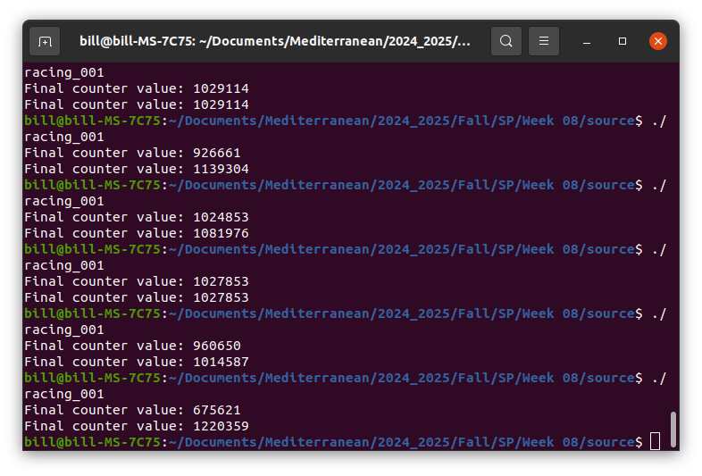
A Typical Output

Slide 7
The Critical Section Problem
In concurrent programming, a critical section is a code segment that accesses a shared resource. When multiple processes or threads try to access the same shared resource concurrently, it can lead to race conditions and unpredictable behavior. This is known as the critical section problem.
A race condition occurs when the outcome of a program depends on the timing of events. In the context of shared resources, it can lead to data corruption, incorrect results, or system crashes.

Slide 8
Atomic Instructions
In the realm of concurrent programming, atomic instructions are fundamental operations that execute indivisibly. This means that once an atomic instruction starts, it cannot be interrupted by another process or thread until it completes. This property is crucial for ensuring data consistency and preventing race conditions.
So, essentially, an atomic instruction (or atomic operation) is any operation within a process that cannot be interrupted by another process (or whatever).
Can you think of some atomic instructions?

Slide 9
Common Atomic Operations
Read-Modify-Write Operations: These operations read a value from memory, modify it, and write it back in a single atomic step. Examples include:
  Incrementing or decrementing a value
  Setting or clearing a flag
  Swapping values between two memory locations
Compare-and-Swap (CAS): This operation compares a value in memory with a given value and, if they match, atomically replaces the value in memory with a new value.
Load-Linked/Store-Conditional (LL/SC): This operation involves two instructions:
  Load-Linked: Reads a value from memory and sets a flag.
  Store-Conditional: Stores a new value to the same memory location only if the flag is still set. If the flag is cleared by another process, the store fails.

Slide 10
Why Does This Matter?
Preventing Race Conditions: By ensuring that operations are atomic, we can avoid situations where multiple processes or threads access and modify shared data simultaneously, leading to unpredictable results.
Guaranteeing Data Integrity: Atomic operations guarantee that data is updated correctly, even in the presence of concurrent access.
Simplifying Concurrent Programming: Atomic instructions can significantly simplify the design and implementation of concurrent algorithms.

Slide 11
Does This Solve It?
#include <stdio.h>
#include <stdlib.h>
#include <unistd.h>
#include <sys/types.h>
#include <sys/ipc.h>
#include <sys/shm.h>
#include <sys/wait.h>
typedef struct shared_int {
int i;
int turn;
} shared_int;
#define SHM_KEY 1234
#define SHM_SIZE sizeof(shared_int)
int main() {
int shmid;
shared_int* counter;
pid_t pid;
// Create a shared memory segment
shmid = shmget(SHM_KEY, SHM_SIZE, IPC_CREAT | 0666);
if (shmid == -1) {
perror("shmget");
exit(1);
}
// Attach the shared memory segment
counter = (shared_int*)shmat(shmid, NULL, 0);
if (counter == (shared_int*)-1) {
perror("shmat");
exit(1);
}
counter->i = 0;
counter->turn = 0;
pid = fork();
if (pid == 0) { // Child process (turn == 1)
for (int i = 0; i < 1000000; i++) {
while (counter->turn != 1) {
continue;
}
counter->i++;
counter->turn = 0;
}
} else { // Parent process (turn == 0)
for (int i = 0; i < 1000000; i++) {
while (counter->turn != 0) {
continue;
}
counter->i++;
counter->turn = 1;
}
wait(NULL);
}
printf("Final counter value: %d\n", counter->i);
// Detach and remove the shared memory segment
shmdt(counter);
shmctl(shmid, IPC_RMID, NULL);
return 0;
}

Slide 12
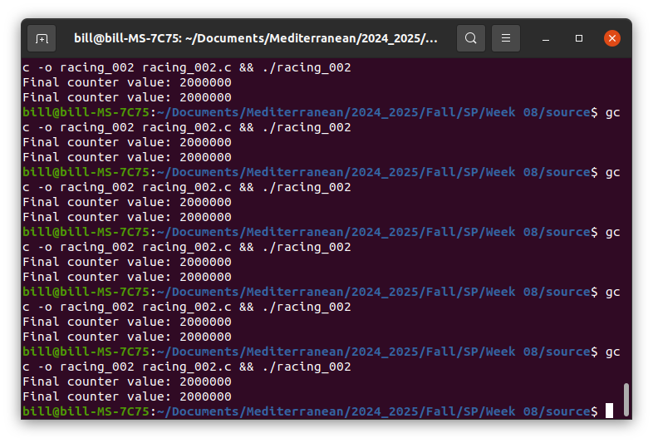
A Typical Output

Slide 13
Troubles In Paradise…
Open source/racing_003.c
What is the difference from source/racing_002.c?
How does this affect the execution of our program?
  Run it to find out!
What does actually happen in this case?
  Think of a more realistic scenario that corresponds to this case.

Slide 14
Starvation
Starvation is a condition in concurrent programming where a process or thread is indefinitely denied access to a shared resource, even though the resource is available. This can occur due to various reasons, including unfair scheduling algorithms, improper synchronization, or resource contention.
This is the case with the above scenario, where a process (in the above, the child), permanently denies access to another process to a shared resource (a shared counter).
While in a dummy manner, a realistic case might be a bug on one of the two processes that remains uncaught for some amount of time, leading to it hanging.

Slide 15
Causes Of Starvation
Unfair Scheduling: If a scheduler consistently favors certain processes or threads over others, it can lead to starvation.
Priority Inversion: A higher-priority process might be blocked by a lower-priority process, leading to starvation of the higher-priority process.
Resource Contention: If a resource is heavily contended, some processes might be unable to acquire it, leading to starvation.
Deadlock: A deadlock can indirectly lead to starvation, as processes involved in a deadlock may never release resources, preventing other processes from accessing them.

Slide 16
Starvation Prevention
Fair Scheduling Algorithms: Using fair scheduling algorithms, such as round-robin or priority-based scheduling with aging, can help prevent starvation.
Priority Inheritance: A higher-priority process can inherit the priority of a lower-priority process that holds a resource it needs, preventing priority inversion.
Resource Allocation Strategies: Careful resource allocation and deallocation can help avoid resource contention.
Timeout Mechanisms: Setting timeouts for resource acquisition can prevent processes from waiting indefinitely.
Careful Synchronization: Proper use of synchronization mechanisms like semaphores, mutexes, and condition variables can help prevent starvation.

Slide 17
A Novel Idea
Previously, we tried to use a single flag that was either true (1) or false (0) to denote access to one of the two processes each time.
This seemed to work, however, as we have just discussed, it runs the risk of leading one of the two processes to starvation in case of malfunction.
So, what if we use two flags instead of one?
Check out source/ipc_004.c.
  What is the logic behind this approach?
  Run it a few times (at least 10).
  Does it work?

Slide 18
Another Idea…
Why did the above idea fail?
Mostly because we did not work carefully enough, since there are cases where both processes mutually exclude one another from accessing their shared counter.
So, what if we:
  First waited on each process for the other and;
  Then change the status from pending to active.
Open and run source/ipc_005.c
  What do you observe?
  Does this work? (Run it 10+ times)

Slide 19
Desperation
So far, nothing has proved any useful, either because we might modify the shared resource simultaneously or because of mutual exclusion or because of starvation of one process or…
Can you think of another idea?
If not, consider inspecting source/ipc_006.c
  What is the idea in there?
  Do you expect it to work?
  Run the program a few times (20+) to find out.
  So, does it really work?

Slide 20
Peculiarities…
Consider the following scenario (each line contains the command each thread will run next, bold text corresponds to actually run commands):
Parent | Child
counter->c (True) | counter->c
counter->p = False | counter->p (True)
counter->p = False | counter->c = False
counter->p = True | counter->c = False
counter->c (False) | counter->c = False
counter->c (True) | counter->c = True
counter->c (True) | counter->p (True)
the same → loop!

Slide 21
Peculiarities…
This is a scenario which, if repeated indefinitely, will result into a deadlock - no one enters their critical section.
You might say that this is rare, but, is it?
  One server
  10,000 clients (a modest company)
  How many requests per hour? Day? Month?
  → There is plenty of room in real life cases for such things to happen.
This is a hard thing about debugging concurrent programs: You can’t just “unit test” them as sequential ones. You have to prove their correctness with pen and paper (unfortunately…)

Slide 22
Fun Time!

Slide 23
Much Like Your Assignment…
Create a simple C function named foo() that:
takes a string as an argument;
randomly permutes its characters, stripping out any whitespace, and;
returns the mutated version of the string.
Using this as a mock “service” implement IPC between a parent process which shares a user provided string and a child process which mutates that string using foo() and returns the mutated version to the parent process. You should implement this in the following three different ways:
Using pipes.
Using shared memory.
Using message queues.

Slide 24
Nasal Demons
It is a well known fact that the C compiler can do a lot of stuff at its own will and discretion. One of the most popular capabilities of the C compiler is that of making demons fly out of your nose. Your mission for this exercise is to:
Find out what is the relationship between nasal demons and the C compiler and summarise your findings.
Try to reproduce this behaviour — in the context of its original first appearance in this world, do not try to manipulate demons through your nose in any realistic manner!

Slide 25
What About The Critical Section Problem?
Today we discussed about a really new problem, the Critical Section Problem. So far, we have not found a convincing solution to it, albeit we have explored four alternatives that, under certain restrictions, provide some partial solutions.
So, can you think how we might take advantage of the strengths of the solutions we have presented so far to address the Critical Section Problem?
Implement a full solution to the Critical Section Problem in C using system calls, in the context of the shared counter we have explored today.

Slide 26

Any Questions?
Don’t forget to fill-in the questionnaire (check right)
https://forms.gle/aj7pYsK1ksufD6xYA

